Slide 1


2019 Term 6
50.012 Networks Project
Start Journey
Zhu Bo
Luo Yifan
Liu Yanbo

Slide 2

Contents
Home page
Transition
Main page
Chart page
The end
Problem Statement
– We want to examine the differences between Socks5 proxy and HTTP server (HTTP/1.1)
– We want to examine the performance and mechanism of the common secure proxies : HTTPS, SockS5 over TLS and Shadowsocks

Slide 3
Contents
Home page
Transition
Main page
Chart page
The end
What is Socks 5 proxy?
What are the differences between HTTP and Socks5 Protocol?
Compare three secure proxies：HTTPS, Socks5 over TLS, Shadowsocks
Shadowsocks: When it is widely used for VPN server now?
Company name here
Company slogan here

Slide 4
Contents
Home page
Transition
Main page
Chart page
The end
ShadowSocks was created
SOCKS5 was approved
a free and open-source encrypted proxy project based on SOCKS5 in 2012
SOCKS4 was extended
SOCKS5 was approved by the IETF in 1996
developed/designed by David Koblas in 1992
extended to version 4 by Ying-Da Lee
SOCKS4a was released
SOCKS was born
SOCKS4 was released

Slide 5
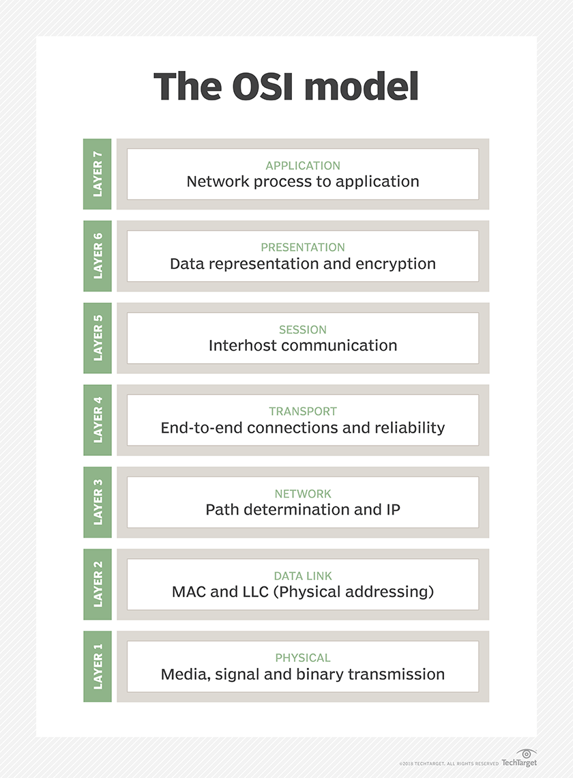
Contents
Home page
Transition
Main page
Chart page
The end
SOCKS5 performs at Layer 5 of the OSI model (the session layer, an intermediate layer between the presentation layer and the transport layer). SOCKS server accepts incoming client connection on TCP port 1080.
HTTP is an application layer protocol designed within the framework of the Internet protocol suite. Its definition presumes an underlying and reliable transport layer protocol,[7] and Transmission Control Protocol (TCP) is commonly used. However, HTTP can be adapted to use unreliable protocols such as the User Datagram Protocol (UDP).

Slide 6
THANK YOU

